Slide 1
Global Temperature Analysis: Understanding Climate Change Trends
Based on work by Ryan Weeks, Sarah Yawn, and Lisa Hansen

Slide 2
Project Overview
Comprehensive analysis of global temperature data Focus on regional warming trends, seasonal patterns, and climate anomalies Exploratory Data Analysis (EDA) Feature engineering and data cleaning Statistical regression modeling Time series forecasting with ARIMA and Prophet models

Slide 3
Research Objectives
Identify long-term temperature trends across different regions
Analyze seasonal patterns and climate anomalies
Forecast future temperature changes using predictive models
Compare how dataset selection impacts climate conclusions

Slide 4
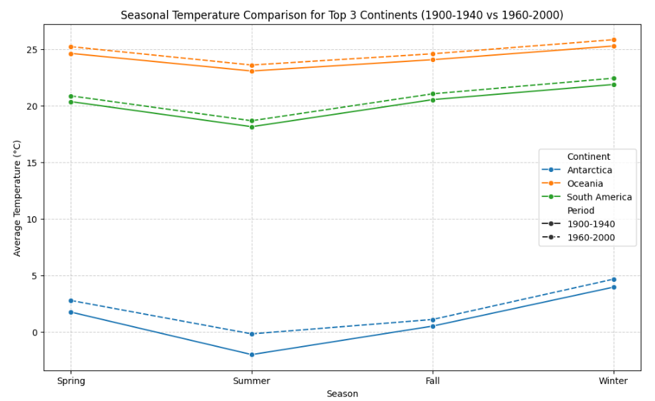
Exploratory Analysis Findings
Visualization of temperature anomalies over time
Rolling averages to identify trends
Regional temperature variation patterns
Seasonal comparisons across different time periods

Slide 5
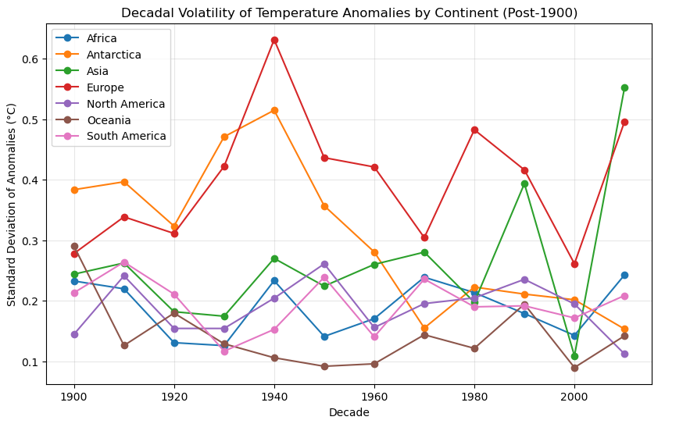
Regional Warming Trends
Uneven warming rates across continents
Identification of regions experiencing accelerated anomalies
Comparative analysis of temperature changes by geography

Slide 6
Regression Analysis
Modeling temperature anomalies as a function of time and geography
Formula: Anomaly ~ Year + Continent
Key coefficients and their interpretation
Statistical significance of findings

Slide 7
Time Series Forecast
ARIMA
Autoregressive Integrated Moving Average modeling approach
Parameter selection and model validation
Forecast results and confidence intervals
Limitations of ARIMA for climate forecasting
Prophet
Facebook's Prophet model implementation
Handling of seasonality and trend components
Forecast trajectories under current trends
Comparison with ARIMA results

Slide 8
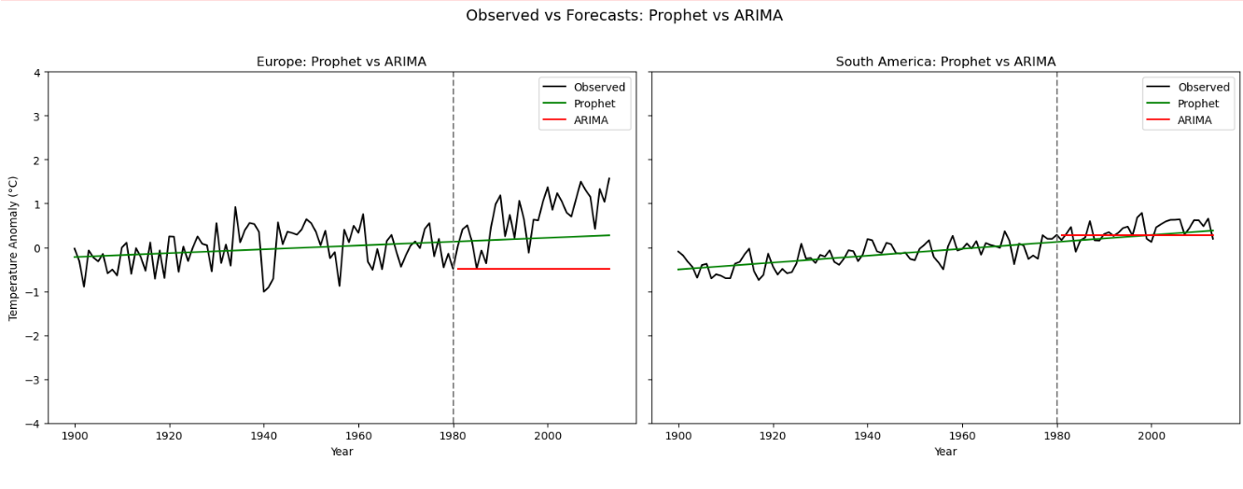

Slide 9
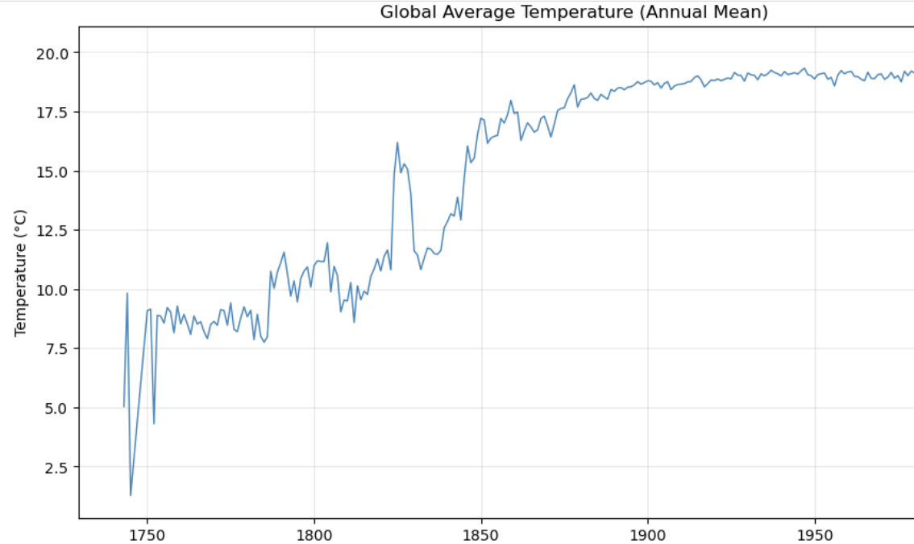
Important Dataset Exclusion
Impact of historical record quality on conclusions
Comparison between full dataset and post-1850 data
Differences in trend detection and forecast outcomes
Implications for climate research methodology

Slide 10
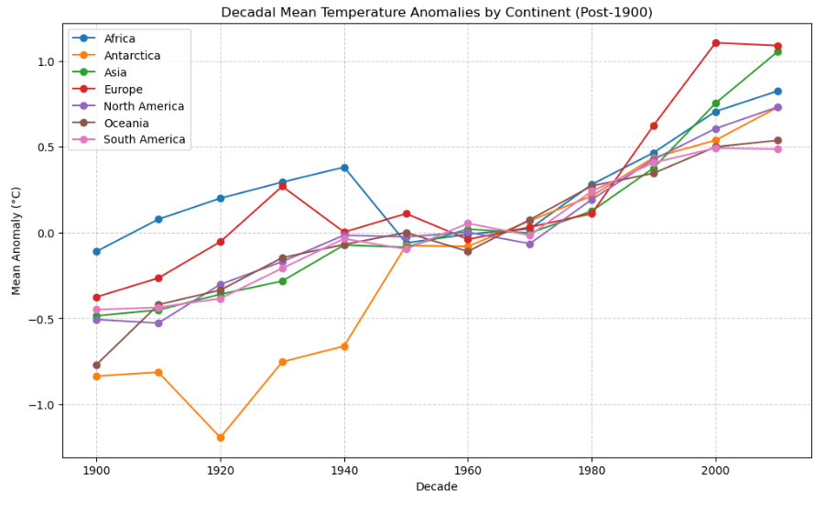
Key Findings
Confirmation of global warming trends with regional variations
Quantification of warming rates across different continents
Seasonal pattern changes identified
Importance of dataset selection in climate analysis

Slide 11
Implications and Applications
Contributions to climate science understanding
Policy implications for regional climate adaptation
Methodological insights for climate data analysis
Future research directions

Slide 12
In Conclusion
Summary of key insights
Limitations of current analysis
Recommendations for future research

Slide 13
Thank You
Q&A

